Slide 1
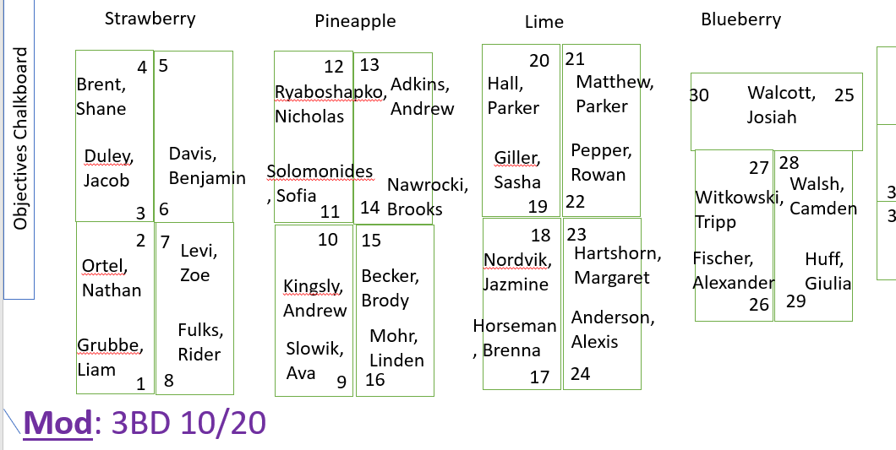
Find your new seat.
Take out your old table bag from the cabinet, take the bag to your old table.
Take your sketchbook to your new table.
Thursday, October 20, 2022

Slide 2
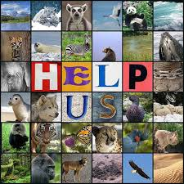
Objective
Students will discover and research an endangered animal to gather information for an informative painting.

Slide 3
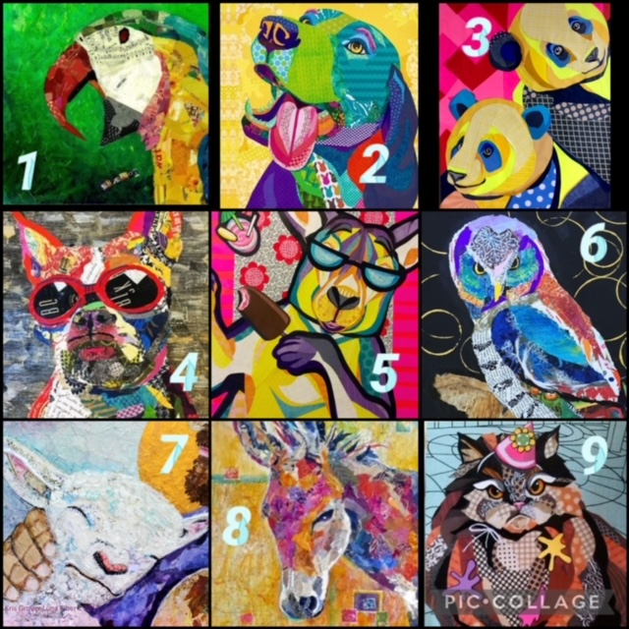
Which animal are you most connected with today?

Slide 4
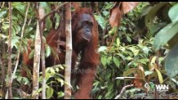

Slide 5
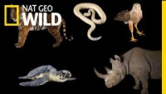

Slide 6
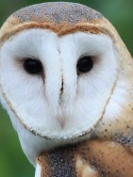
Today’s Assignment
In Schoology, open the assignment “Endangered Animal Fact FIle”
For your next artwork, you will be using various brush techniques and color mixing to create a realistic portrait of an animal. In choosing an animal, our focus will be on the animals around the world who are endangered, to raise awareness about the status of these amazing creatures. Today, you will complete some preliminary research about an animal on the endangered list. Try to choose an animal you are not familiar with, and if possible, choose a different animal then the other students at your table.
Use the WWF website to find select your animal. You may do outside research as well. https://www.worldwildlife.org/species/directory?direction=desc&sort=extinction_status
Follow the directions on slide 2 in order to complete slides 3 and 4.

Slide 7

I finished early, now what?
Go-To Game!
Click the Sandiego Zoo link at the bottom of our lesson page

Slide 8
Looking Forward
Your endangered animal slide must be uploaded the day before next class.
1
Continue checking your grades on Schoology.
2
Send me a message as needed.
3
Have a great day!
4

